Slide 1



Information Modeling (IM) Project / Federal Health Information Model (FHIM)
Logical information model and associated terminologies/value sets
Integrated with implementation modeling tools
Leverages a model driven architecture (MDA) approach to generate information exchange (IE) implementation standards
Automates MDA steps to maximum extent possible
High-level MDA steps are:
  Model information in FHIM and separately define terminologies and value sets to support the FHIM (FHIM is platform independent model (PIM))
  Use implementation modeling tools (i.e. Model Driven Health Tools (MDHT) to generate a use case specific PIM
  Use MDHT to generate platform specific models (PSM) (e.g., NIEM, CDA, etc.) from use case specific PIM
  Use MDHT to constrain terminologies/value sets and bind them to the PSM
  Use MDHT to generate platform specific IE implementation standard, implementation documentation, test cases and reference implementations

Slide 2
Model Driven Architecture (MDA) View
Describing Relationship Between FHIM and MDHT
Business Models
(BPMN & BPEL)
Used to Generate
Used to Generate
Software Behavior Models
(UML)
Logical (Static) Information Models
(UML)
Used to Generate
This is
FHIM
Used to Generate
Used to Generate
Used to Generate
Information Exchange (IEPD) Models
(XML Schemas)
Physical Databases
(Relational or Other DB)
This is MDHT
Used to Generate

Slide 3

FHIM Model Driven Architecture
Approach
FHIM Model
(PIM)
1
Uses
Lab Domain Integration Use Case
Constrains
2
Uses
Lab Domain Exchange (PIM)
Platform Independent
4
5
Platform Specific
MDHT
Transform
CDA Exchange PSM (UML)
NIEM Exchange PSM (UML)
8
Generate
Transform
Transform
Generate
9
6
7
CDA Implementation Guide Document
CDA Exchange Implementation
(Java)
NIEM Exchange PSM Implementation
(XSDs)
NIEM IEPD
Document

Slide 4
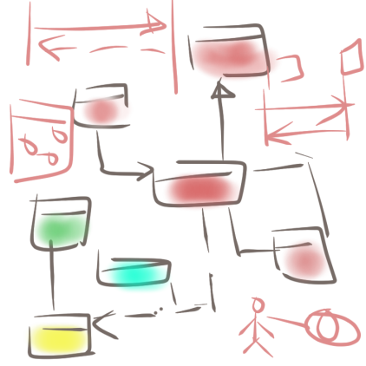
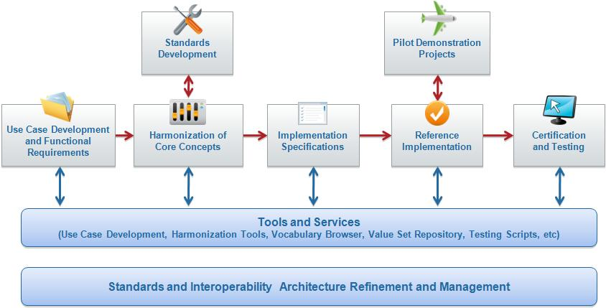
Standards Change Requests
3
Use Cases
Functional Requirements
1
2
Implementation specification
NIEM IEPD
CDA IG
FHIM
Terminology Service

Slide 5
Prototype Steps: 1-3
FHIM.emx
FHIM.emx
HITSP IS01
1
3
Use Case
Information
Requirements
Semantic Model Metadata
2
Harmonized
HITSP C35. C36, C37, C83
Coded Concept
Value Set Binding
HITSP C80/35
Terminology Model
Standard Coding System
Standard Coding System
Standard Coding System
Standard Coding System

Slide 6
Prototype Steps: 4-5
CDA HITSP C37
FHIM.emx
Constraints
Clinical Document
Header
4
*
*
Section
*
*
5
Entry
Constraints
Choice
Act
NIEM
Extensions
Encounter
References
Extension
Observation
Media
Use Case
Organizer
Terminology Model
Procedure
IEPD
Region of
Interest
RSA 8.02 + MDHT Tools
Substance
Administration
constraints
<template>
LabResult
Supply

Slide 7
MDA: PIM-to-PSM and Testing Approach
Use Case
Information
Requirements
Use Case
Use Case
Terminology Model
Platform Independent Model (PIM)
Platform Specific Model (PSM)
CDA JAVA API
NIEM XSD
NCPDP SCRIPT XSD
HL7 V3 XSD
HL7 V2 XML Profiles
Other Examples
Test Cases
Reference Implementation
Reference Implementation
Reference Implementation
Reference Implementation
Test Cases
Test Case
Validation/Test Harness

Slide 8
IM Project Summary
The IM Project/FHIM:
Produces freely available, harmonized information and terminology models and value sets
That are integrated with open source model-driven health tools
That can support multiple implementation platforms (PSMs), including NIEM
And that can support the goals and requirements of the S&I Framework

